Slide 1


Mysterious Case of Hypotony
Asia-Pacific Glaucoma Congress
Paul Palmberg, MD, PhD
Bascom Palmer Eye Institute

Slide 2
In the beginning….
70 y/o Argentinian man with controlled POAG years after a trab underwent a 26g PPV for a peripheral rhegmatogenous RD.
Post-operatively the patient had hypotony and low serous choroidal detachments. They were observed for a month, then we were called.
The IOP was 3 mm Hg, Va 20/50, AC deep and quiet, no RD on dilated fundus exam or B-scan ultrasonography. No cyclodialysis cleft on gonio, nor on anterior segment UBM of the angle recess.
We observed out to 3 months, without resolution, and he began to get corneal edema and flattening of the bleb.
WHAT WOULD YOU DO NOW?

Slide 3
NEXT STEP
We drained the serous choroidal detachments.
To deal with the expected IOP spike and apparently failed trab?
We placed a prolene-ligated Ahmed Implant
But, the IOP did NOT rise as had been expected.
What now?

Slide 4
On the way to the OR….
My thought was that the patient probably had a cyclodialysis cleft created by the trocar of the 26g vitrectomy.
I planned to use an endo probe to view the angle and find the cleft.
I happened to discuss the case with Dr. Ta Chen “Peter” Chang, who mentioned seeing such a case in which the cleft was behind the iris!
At surgery, we could NOT find a cleft in the angle.
We inflated the sulcus with viscoelastic and searched for the cleft with the illuminated endo probe…saw two suspicious areas, corresponding to where trocars had been used in the PPV.

Slide 5
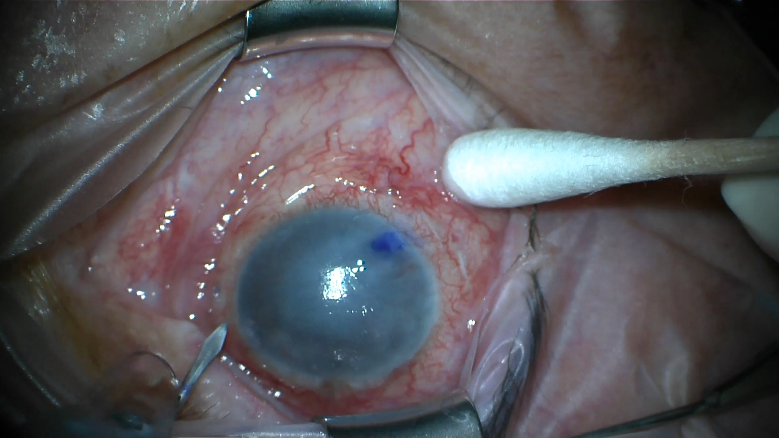
Using double flap modification of the technique of: Kuchle M, Naumann GOH. Direct cycloplexy for traumatic cyclodialysis with persisting hypotony; report in 29 consecutive patients. Ophthalmology 1995; 102: 322–233

Slide 6
Key Points
Sort out the problems: glaucoma, hypotony, choroidals
Provide a solution for all of them
  Choroidals drained could mean pressure spike if bleb failed, need alternative means of controlling IOP, but adjustable, once the choroidals are gone, thus the prolene-ligated (on the AC portion of the tube) Ahmed Glaucoma Implant
  When that failed, and bleb failed and cornea clouding, needed to assess for hidden cleft, presumably from the PPV trocars.
  Endo probe a big help, with viscoelastic to widen angle
  When no cleft in angle, viscoelastic used to widen the sulcus
  2-scleral flap technique to explore for cleft, using fluorescein-BSS
  After closing cleft and inflating eye, IOP held, so time to cut the prolene on the AGI to control the IOP
  Final point, listen to your junior colleagues

