Slide 1

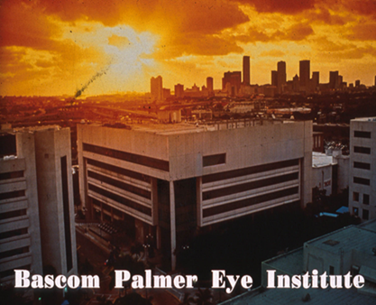

Laser Treatment in Angle Closure
Paul Palmberg, MD, PhD

Slide 2
Confirm Angle Closure and Determine the Type
Relative Pupilary Block
-Appositional Closure
-Synechial Closure
Plateau Iris Angle Closure
Other mechanisms:
Aqueous misdirection, ICE, Neovascular, Uveitic

Slide 3
Consider 30g needle paracentesis
(if needed to clear the cornea and relieve the pain)
What to tell the patient
There is a blockage of fluid inside your eye causing the pressure to build up. That causes blurred vision and pain. Let’s treat it.
“First, we need to let a little fluid out, and then examine your eye again.”
Probably we will recommend a laser treatment:

Slide 4
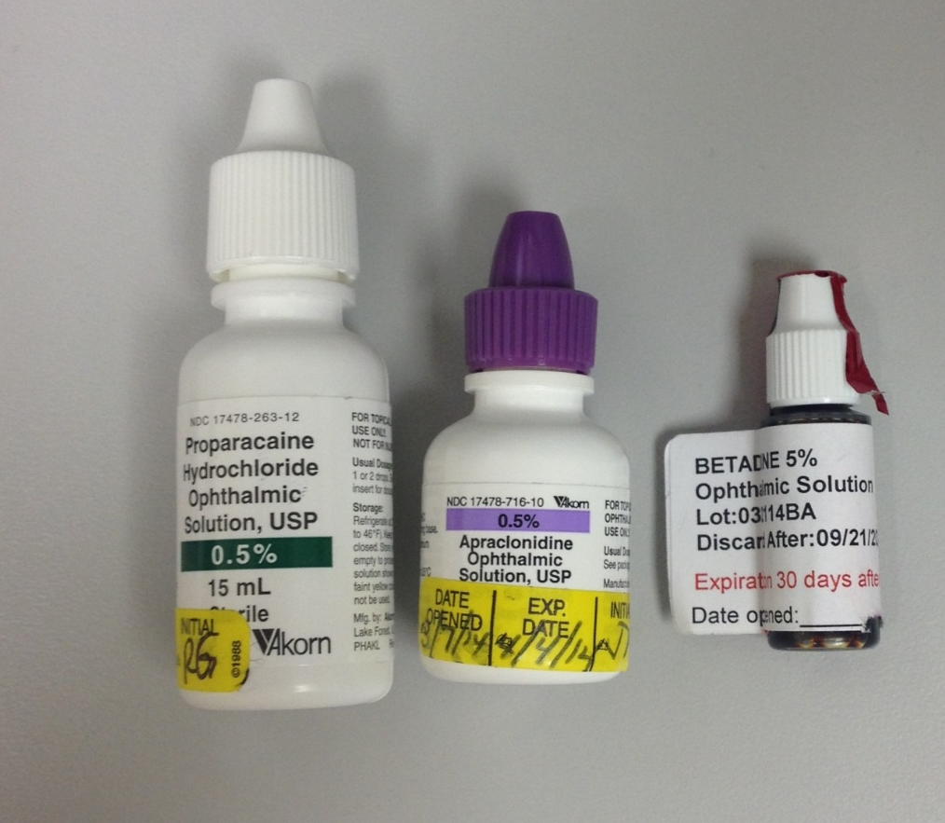
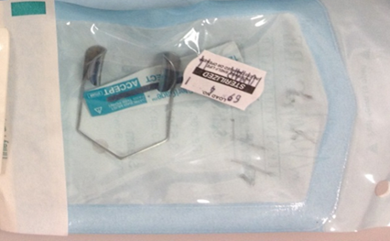
Prep for Slit Lamp Procedure
Proparacaine
Solid Bladed Speculum
Apraclonidine 0.5%
Povidone Iodide 5% drop

Slide 5
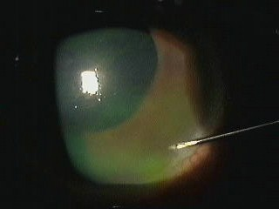
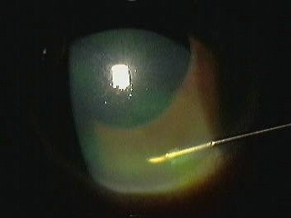
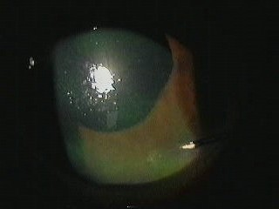
Half inch 30 g needle paracentesis (held by hub) to clear the cornea prior to laser treatments
a) Entry in peripheral cornea, bevel parallel to surface and aimed away from lens
b) Turn to iris parallel and enter
c) In 10 seconds Ta 12 +/- 2 Hg, cornea now clearer

Slide 6
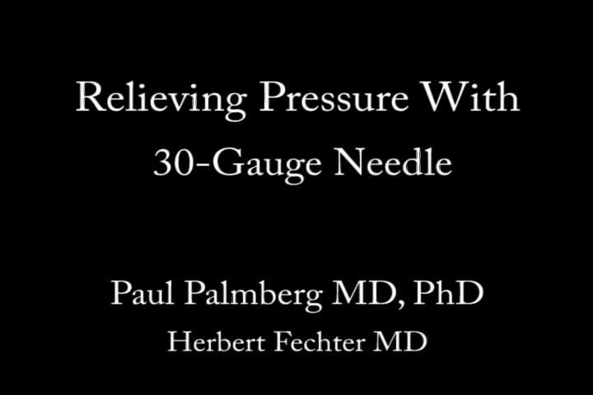

Slide 7
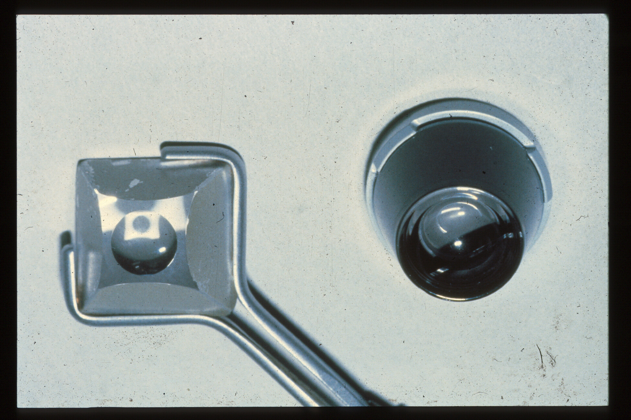
Goldmann lens sucks on cornea!
Zeiss Lens
9 mm interior rim
Goldmann Lens
11 mm interior rim
13 mm exterior rim
Notes:
The Goldmann lens has an outer rim of 13 mm in diameter, that sits on the sclera when applied to the eye, and an 11 mm interior rim. It is more steeply vaulted than the cornea of patients and so the space between the lens and the cornea must be filled with a clear, viscous solution, such as methyl cellulose. When applied quickly to the eye to prevent escape of that fluid, the pressure exerted expels some of the fluid creating a suction cup effect that helps to keep the lens in place, but also distorts the anterior chamber anatomy, which can artifactually open a closed angle. The Zeiss lens on the other hand has a 9 mm interior rim, which sits on the cornea, and its vault closely approximates most corneas, so that a drop of saline or topical anesthetic solution can achieve optical coupling between this lens and the cornea, without creating any suction cup effect. Thus, if the lens is applied without any pressure, it allows avoids raising the IOP, which could otherwise open a closed angle.

Slide 8
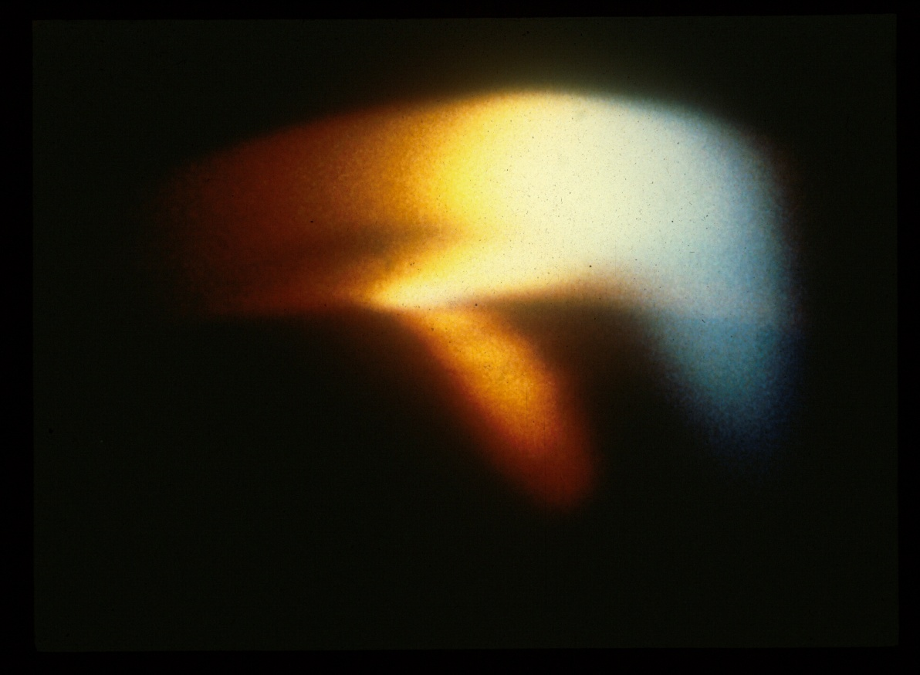
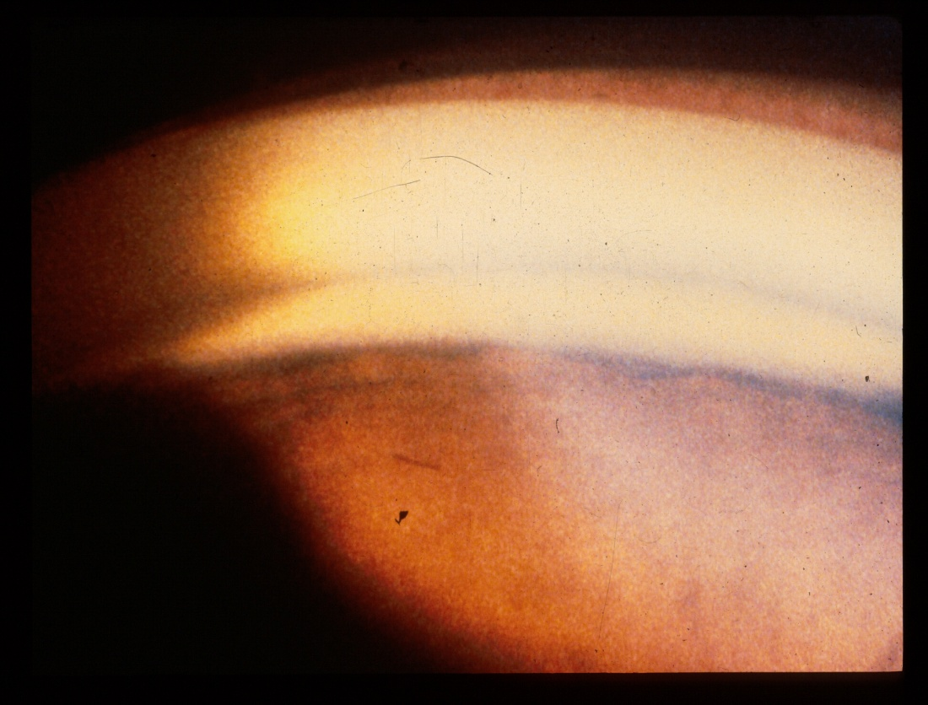
Appositional angle closure on Zeiss gonioscopy!
Goldmann lens suction opens a closed angle, resulting in a missed diagnosis of angle closure!
Notes:
Just to demonstrate the advantage of the Zeiss-style lens, here is a patient with appositional angle closure documented on Zeiss gonioscopy that on Goldmann lens gonioscopy is seen to have an open angle in some portions between focal Peripheral Anterior Synechiae. (That was also true with a narrower slit beam.)

Slide 9
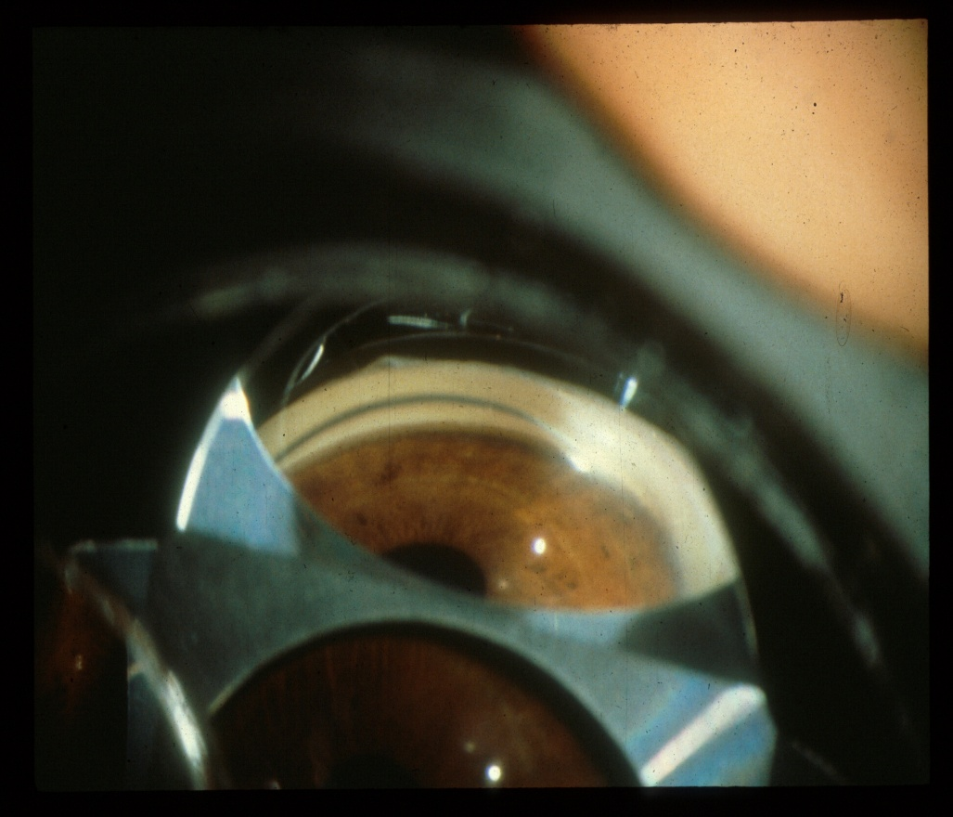
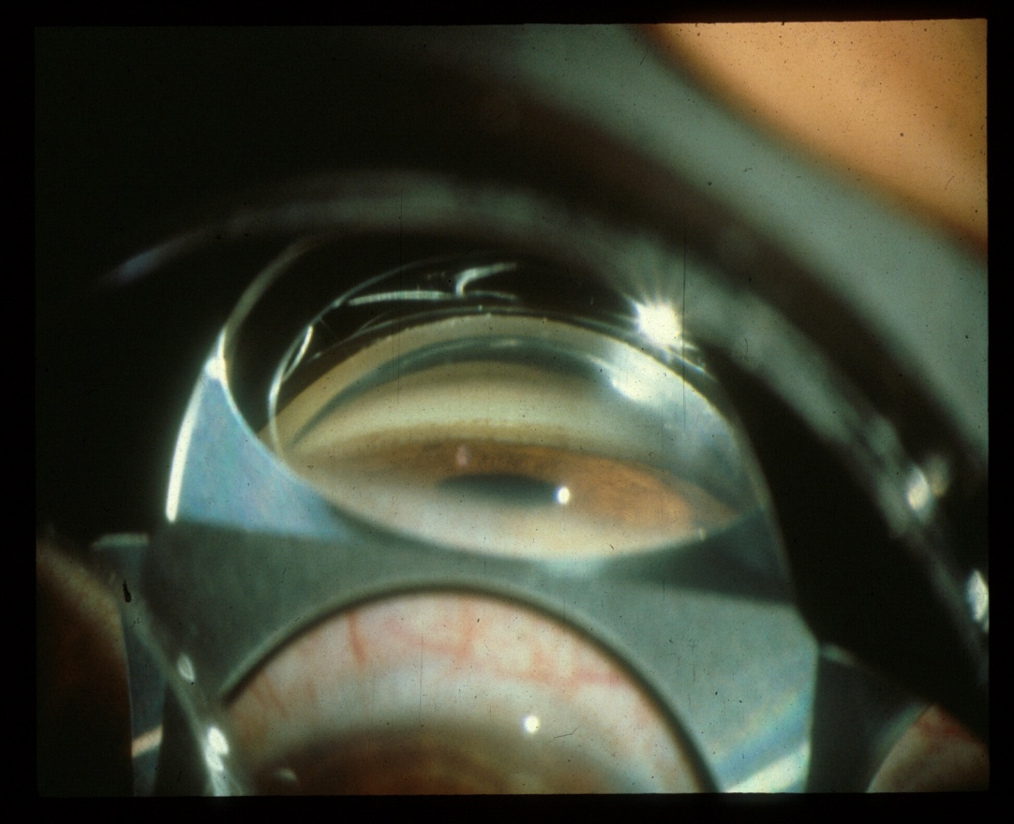
Adjust your point of view
Dive bomber view to see into the narrow space between iris and trabecular meshwork.
Cruise missile view for trabeculoplasty, the closest to perpendicular to the TM
Notes:
When a gradient of pressure between the posterior chamber and the anterior chamber causes a forward bowing of the iris one can have the patient look down about 15 degrees to allow a “dive bomber” view into the narrow space between the iris and the trabecular meshwork. On the other hand, when one is performing laser trabeculoplasty, it helps to have the patient look towards the mirror to obtain a view parallel to the iris, a “cruise missile view” that is more perpendicular to the trabecular meshwork for a better laser application.

Slide 10
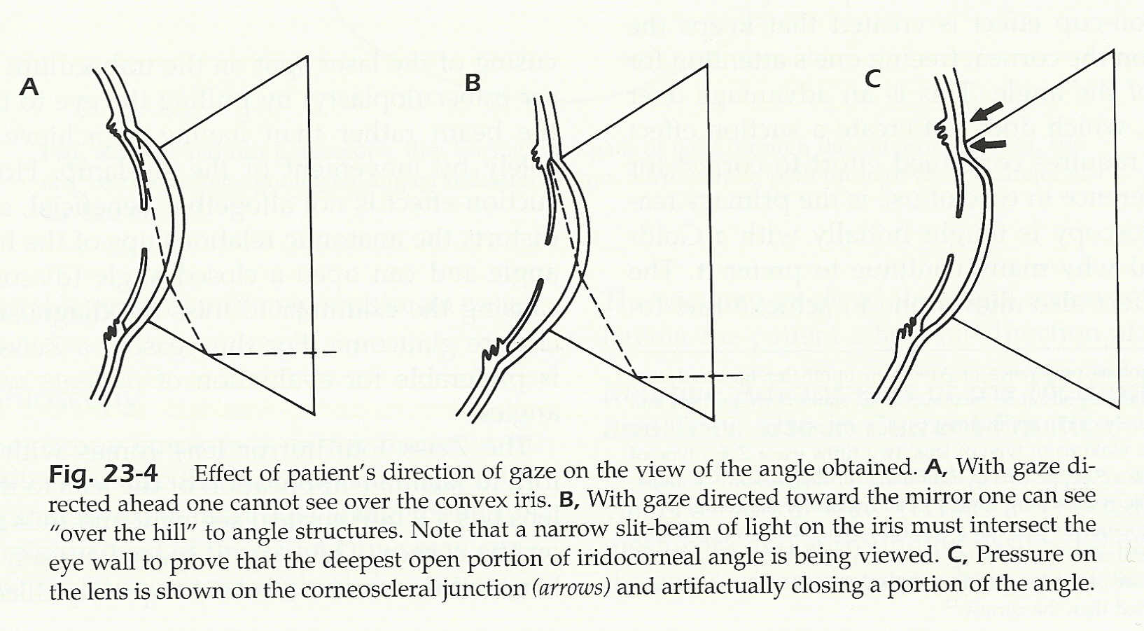
Tell the patient to look down about 15 degrees so you can see “over the hill of iris bombe.
Notes:
These diagrams illustrate that A) a straight ahead eye position may leave the periphery of the iris hidden, while B) having the patient look down 15 degrees lets on look over the peripheral iris to a narrowly open angle, but that C) it is important to NOT press the superior rim of the gonioprism against the cornea as one can artifactually close an angle.

Slide 11
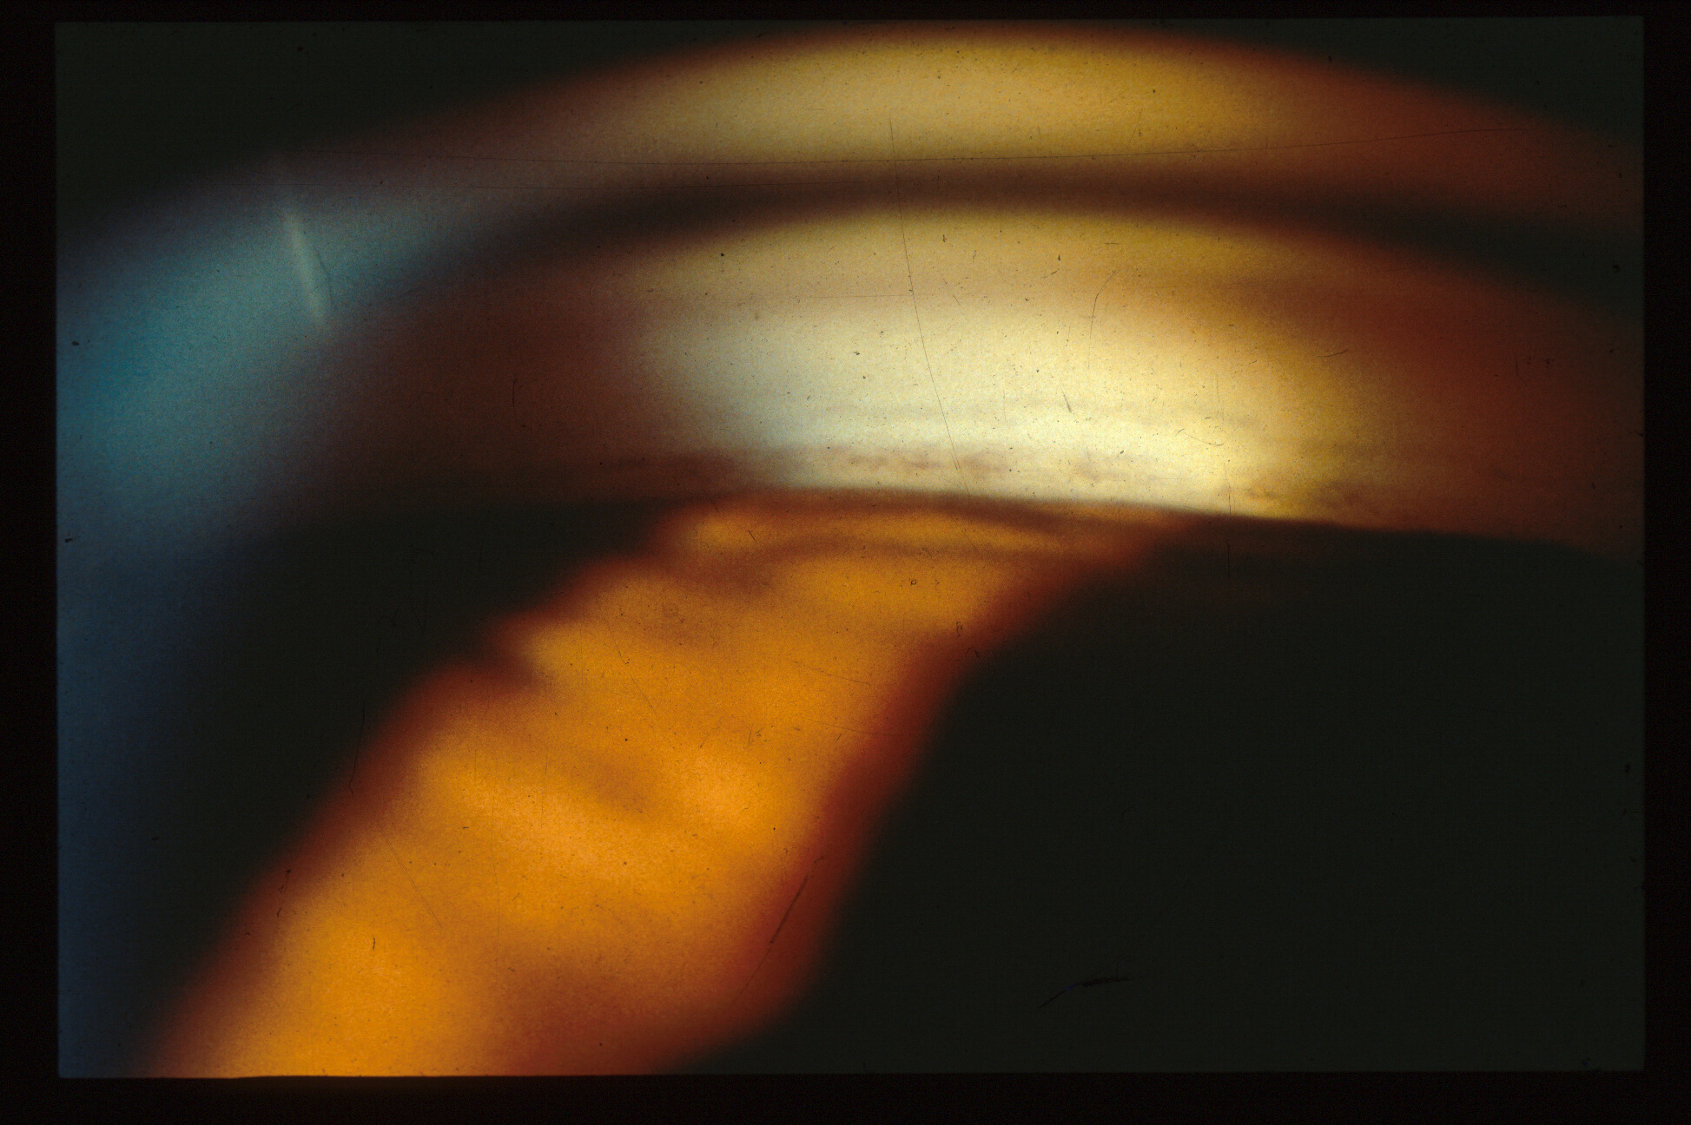
Get pushy! Indentation gonioscopy
Is this the TM?
Notes:
Here is another test case. Is the angle open or closed? In brown irides the iris plane may only be slightly bowed forward in cases of appositional closure as the iris is thicker and stiffer than in blue eyes. Again, there are clues that this might be a closed angle. Not shown was that the corneal light wedge extended to the iris insertion. Here one sees that there is some forward bowing of the iris, and also that the character of the pigment is typical of a Sampaolasi line, with a discontinuous line of “salt and pepper”, or clumps of pigment and bare spaces. SO, we need to perform indentation gonioscopy.

Slide 12
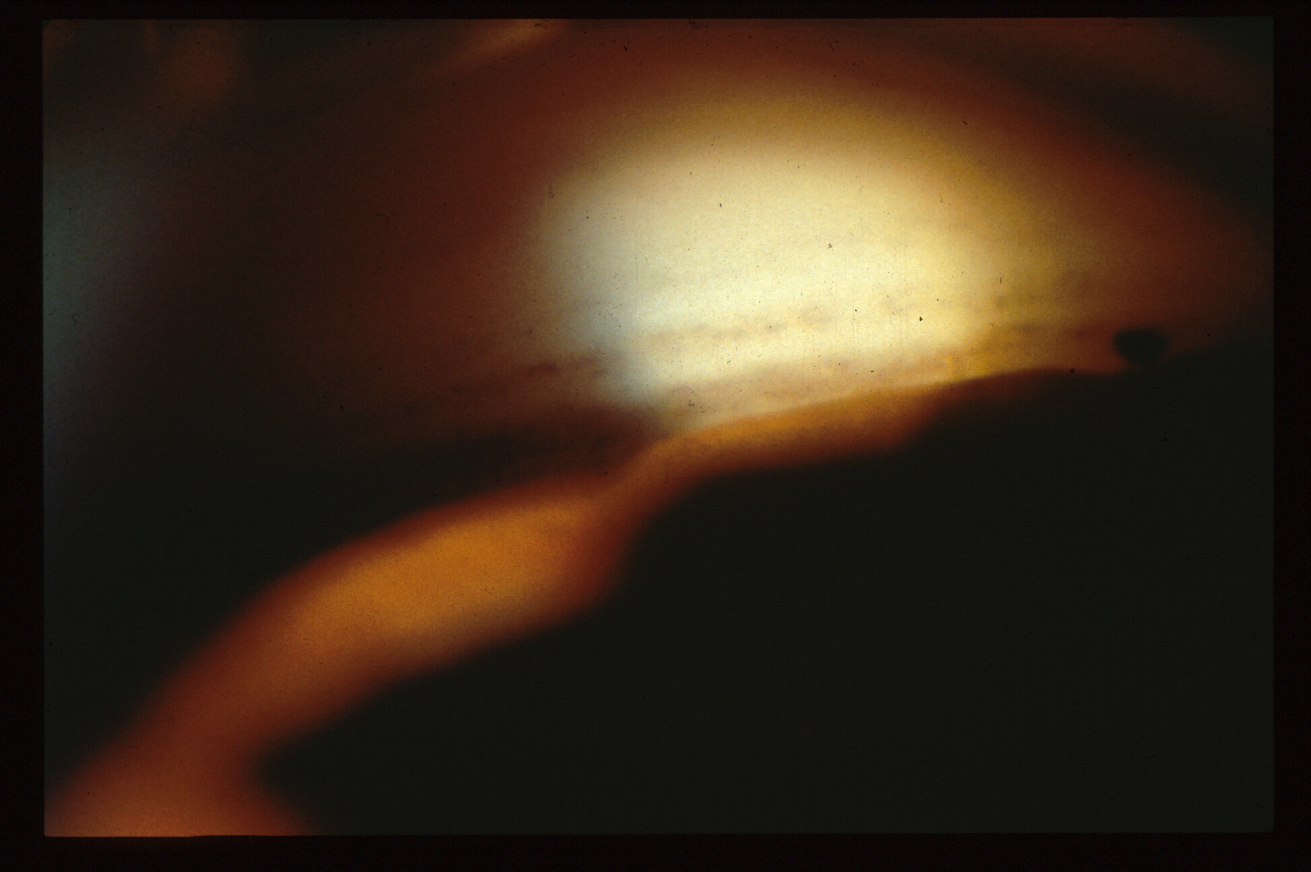
Saompaolasi line, not the TM!
This is the TM
During indentation gonioscopy:
Lifting while pushing so that the inferior third of the rim smoothly indents the inferior cornea
Notes:
With indentation gonioscopy, now revealed is the previously hidden true trabecular meshwork with a continuous line of pigment resembling “fine powdered brown sugar”.

Slide 13
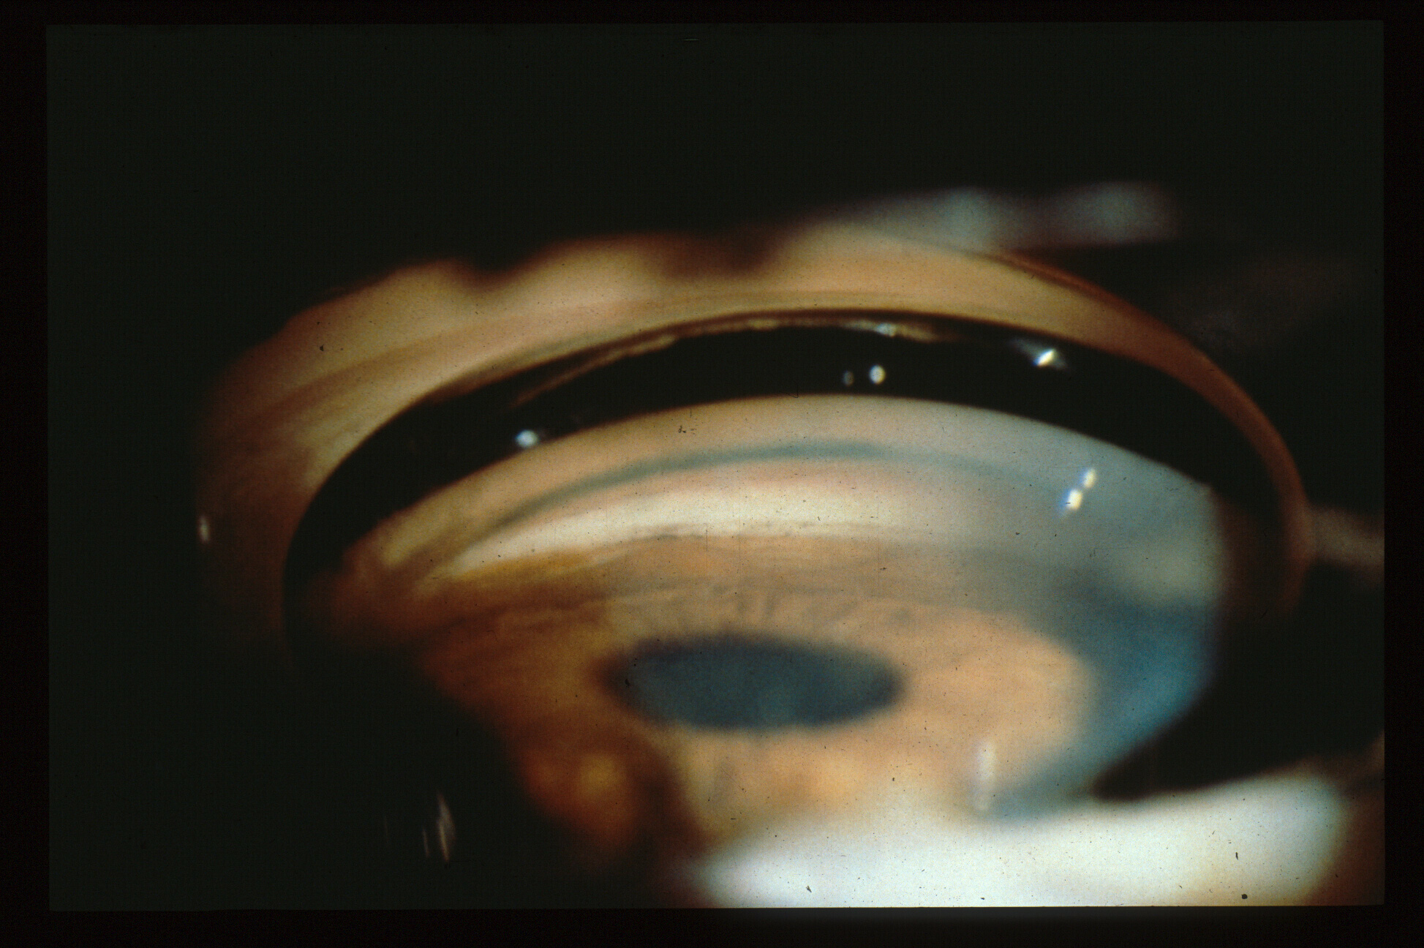
PAS tethers iris during indentation while adjacent iris moves backwards
Notes:
Dynamic gonioscopy, in which one pushes and releases pressure on the cornea, also helps in distinguishing PAS from iris processes, as PAS will tether the iris in place, while the iris in adjacent areas of appositional closure can move down away and back up.

Slide 14
Technique of LPI
Find a crypt or thin area temporally, with the patient looking temporally, avoid arcus, also avoid LPI at tear meniscus to avoid photopsia
Argon 500 u spot for 1 sec 0.18-22 w to contract surface, close vessels
3) YAG at 3-5 mJ to penetrate, aim deep to surface
“Shuffle technique”, pushing laser lens in and out to create to and fro flow, bring any pigment clumps forward in order to remove them, avoid later closure of the LPI
Ritch, R. and Palmberg PF: Argon laser iridectomy in densely pigmented irides. Am J. Ophthalmol. 93:800‑801, 1982. (My shuffle technique)

Slide 15
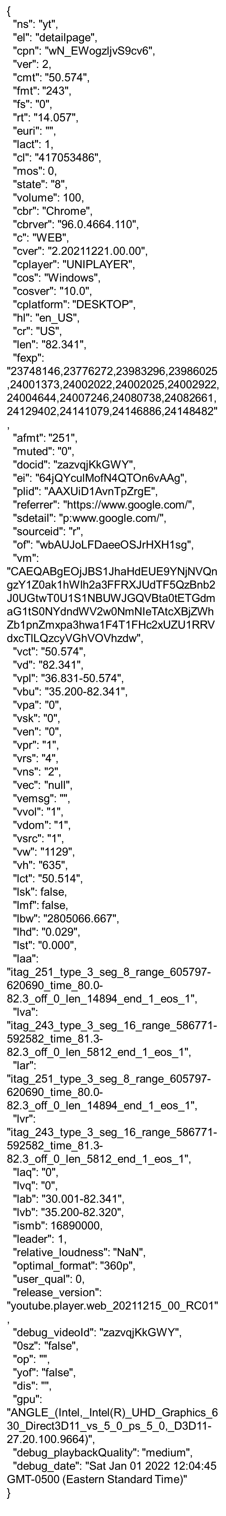
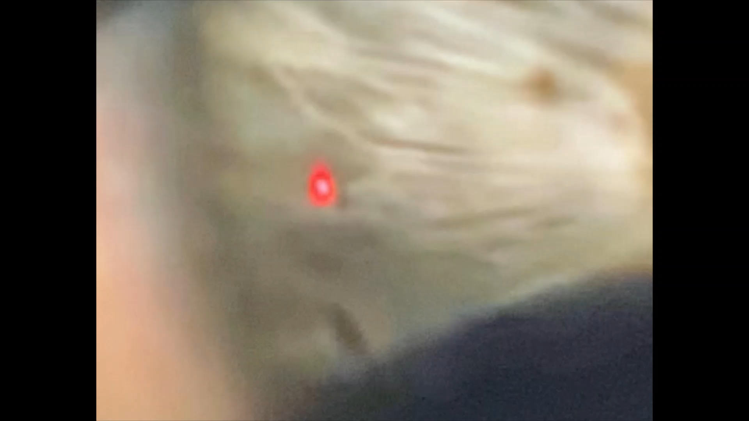
Modified from Miguel Rechichi, MD, PhD EyeTube 2014
Watch for the gush of fluid and pigment.

Slide 16
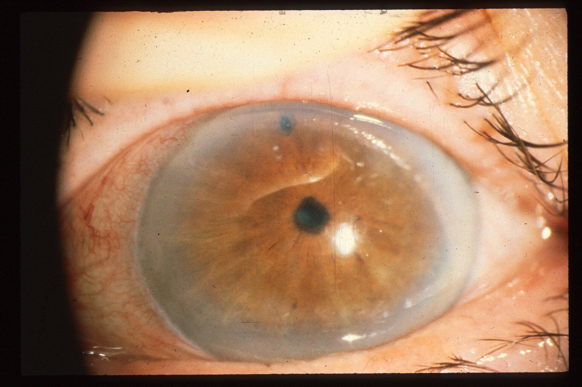
Next case: LPI performed
Notes:
Laser iridotomy in my view is still the preferred treatment for predominantly appositional angle closure, while lens extraction with goniosynechiolysis is likely more effective when there are fairly extensive PAS, or trabeculectomy in cases with near total PAS and advanced optic nerve damage (see Palmberg, Journal of Glaucoma: 2019; 28(9):765-766, which is about plateau iris syndrome management, but applies to pupil block angle closure as well).
The location of the LPI can be important, and is probably best placed temporally with the patient looking temporally as that avoids light being focused as a line on the retina by light passing through the superior tear film meniscus, causing a distressing line in the vision under certain light conditions, and also avoids bubbles formed from obstructing the view during treatment and also aims any laser light reaching the retina in the far periphery.

Slide 17
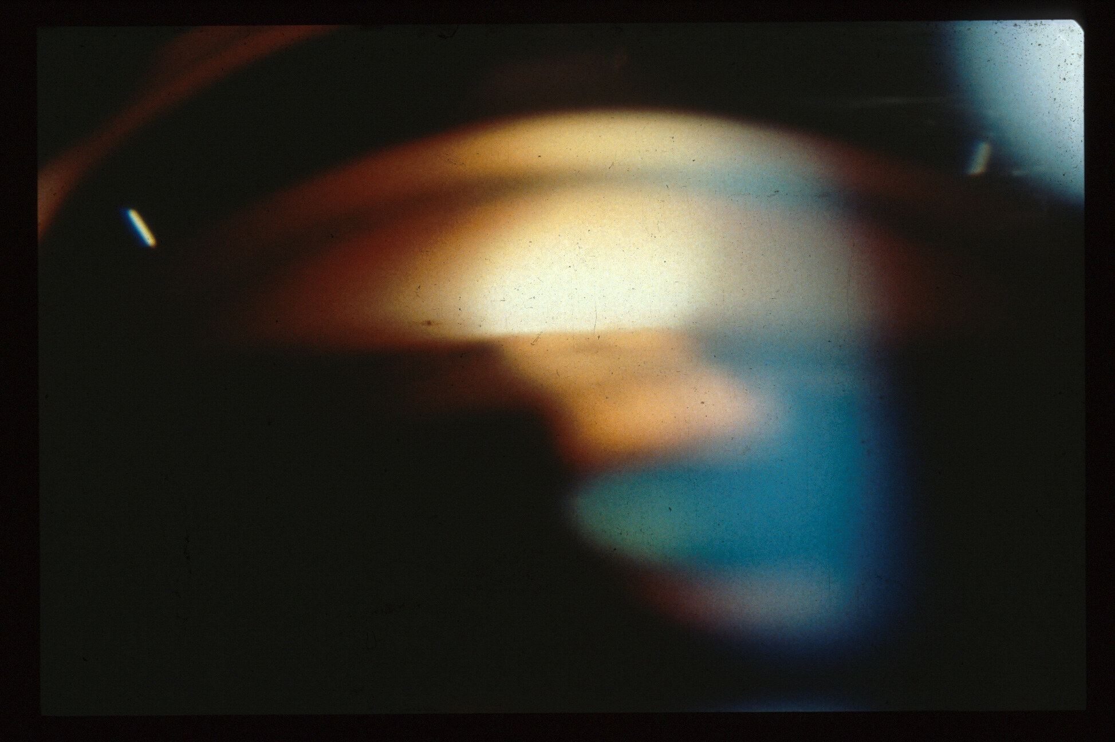
No angle structures visible after LPI: Synechial or appositional closure?
Notes:
After an LPI was placed in this case, the superior angle was still closed. What now?

Slide 18
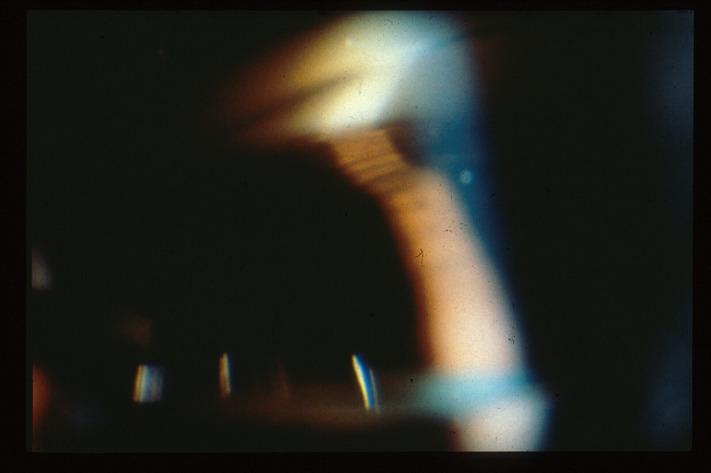
TM now revealed
With indentation gonioscopy: double hump sign
Notes:
Indentation gonioscopy reveals that there was only appositional angle closure, and a “double hump sign”, with the iris draped in the periphery over a “bicycle tire” of forwardly rotated ciliary body processes, or a “plateau iris”.

Slide 19
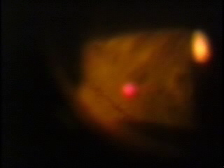
500 micron spot applied 0.5-1.0 sec in far periphery,
0.18-0.22 watts, 24-36 applications, watching for contraction of adjacent iris.
Patient gaze adjusted to allow shots to angle more peripherally. Argon
Laser Iridoplasty, courtesy of Robert Ritch, MD
Notes:
Here is Argon Laser Peripheral Iridoplasty, video courtesy of Robert Ritch, MD

Slide 20
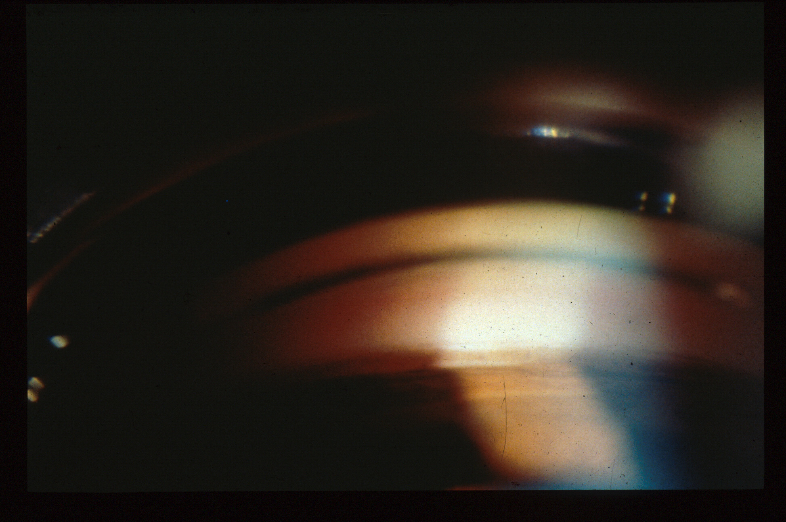
After Laser iridoplasty
Notes:
I still think that in predominantly appositional angle closure due to a plateau iris that peripheral iridoplasty is a highly effective and the least invasive treatment. Lens removal and goniosynechiolysis, coupled with the use of treatment of the ciliary body processes to shrink them with an endolaser is probably better when there are extensive PAS, and trabeculectomy best when there are very extensive PAS and advanced optic nerve damage, in which case the damage to the trabecular meshwork is more likely to be irreversible and the target pressure hard to reach without filteration surgery.

Slide 21
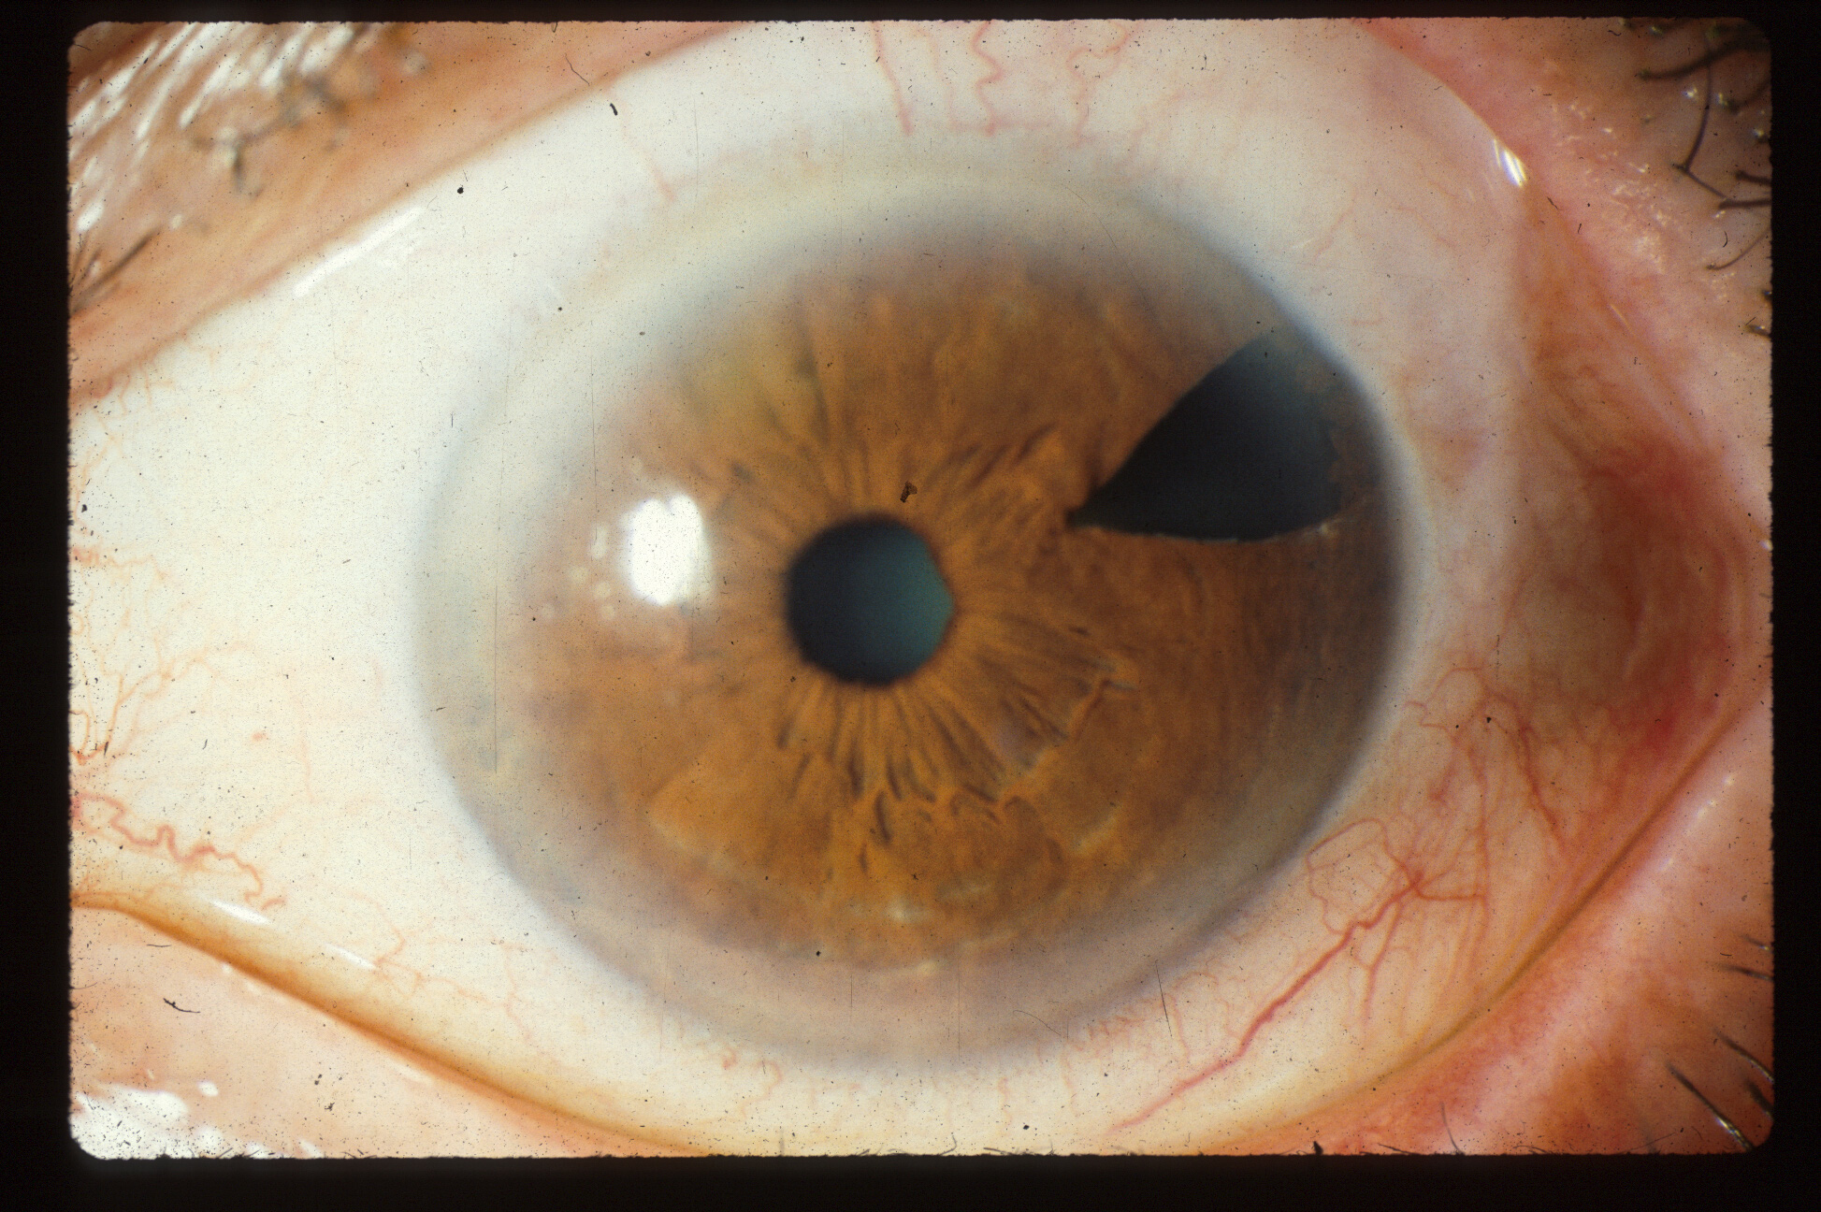
Surgical PI in 1979, recurrent angle closure in 1988—How is this possible?
Notes:
Here is a case of recurrent angle closure developing 9 years after an adequate (surgical) iridectomy. How is this possible?

Slide 22
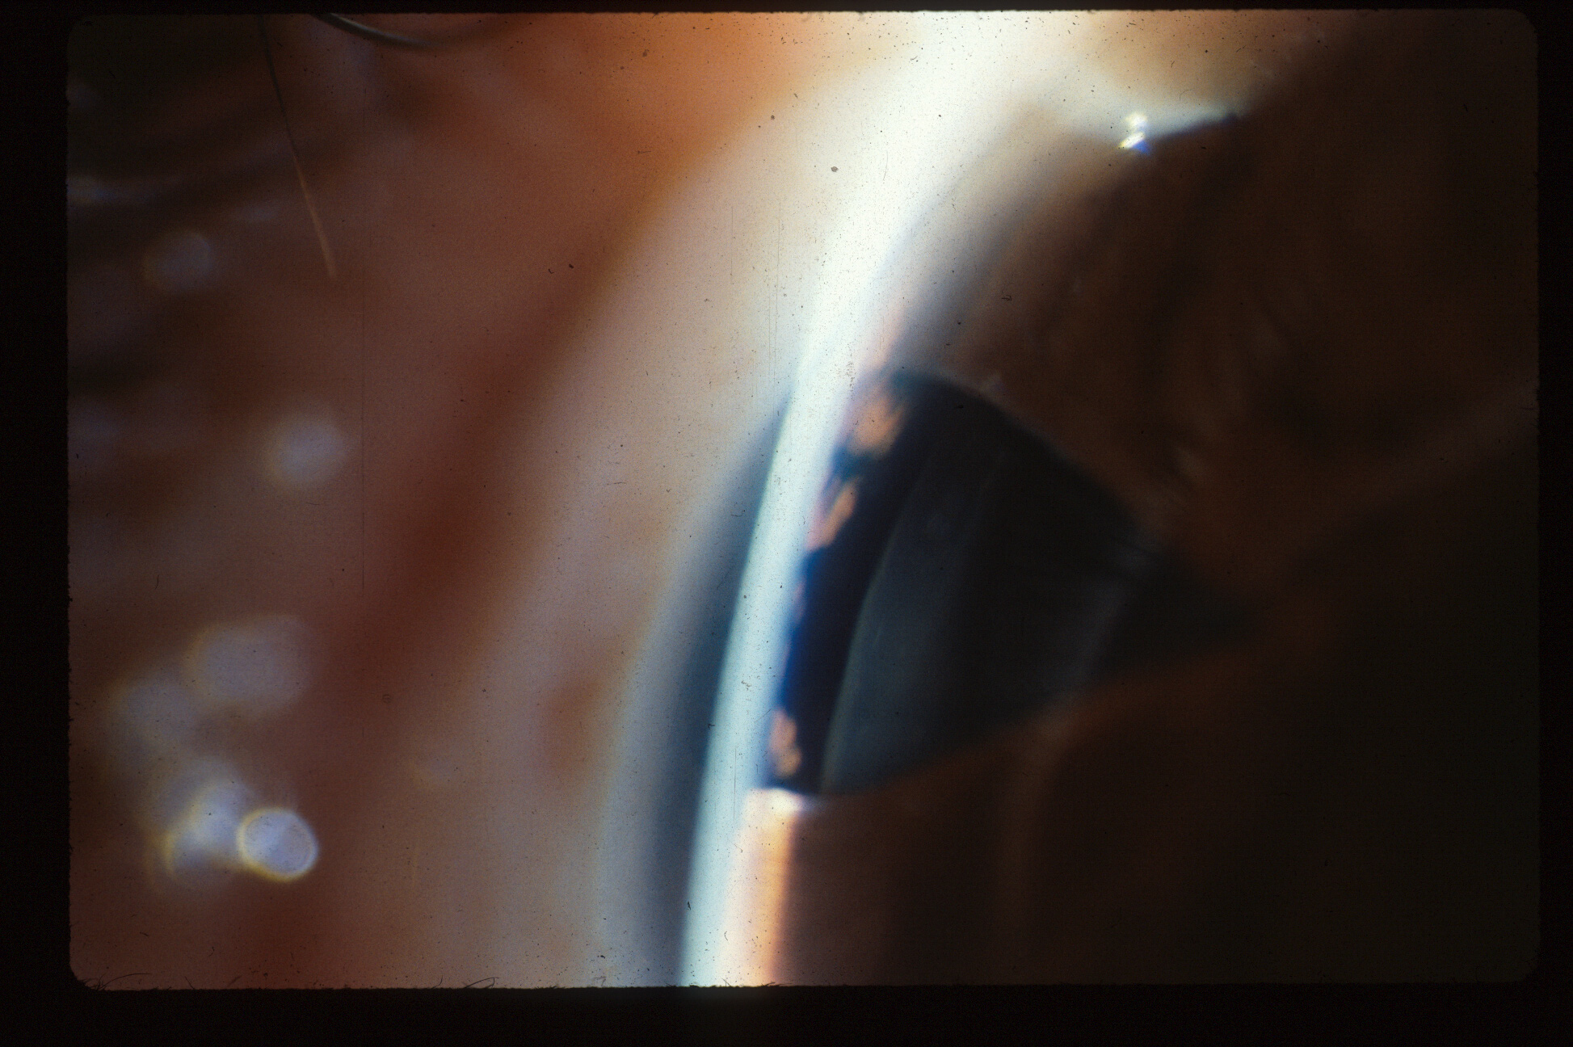
Notes:
Another view. The ciliary body processes are pushing the iris forward.

Slide 23
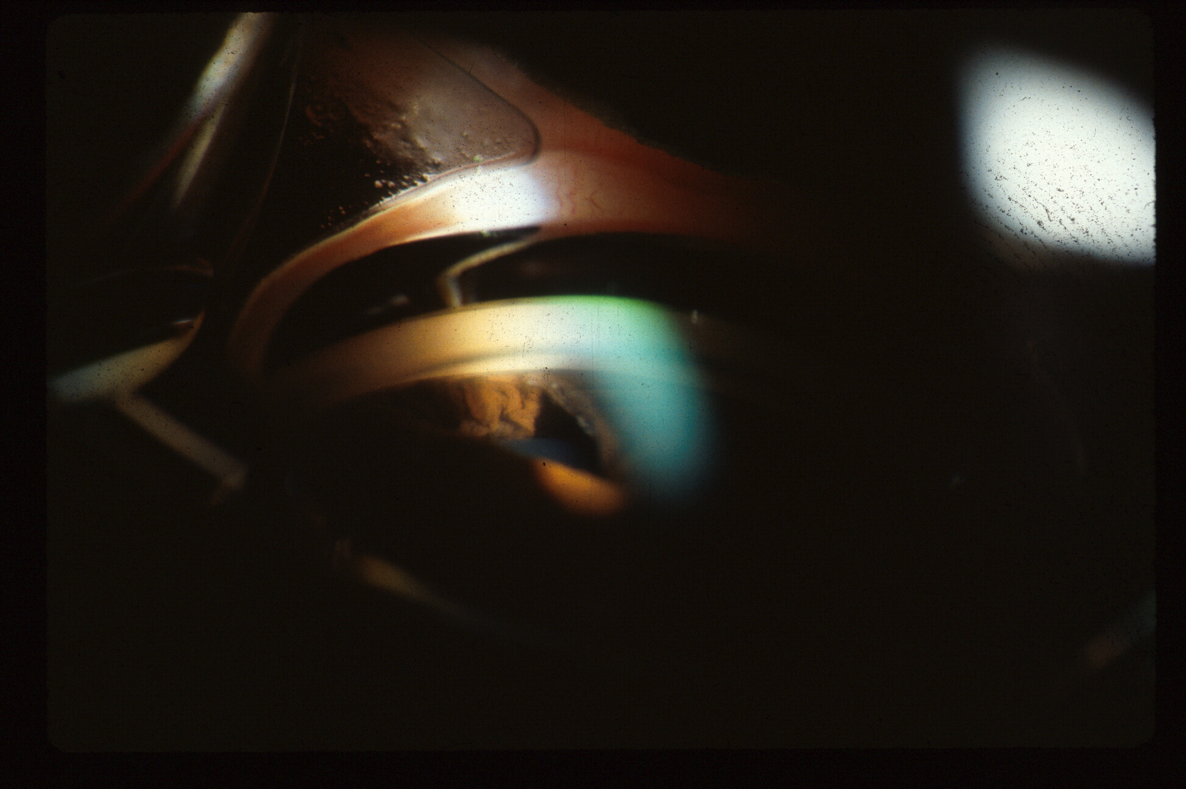
CB Processes are rolled forward prior to indentation gonioscopy in a case of plateau iris syndrome
Notes:
Without indentation gonioscopy

Slide 24
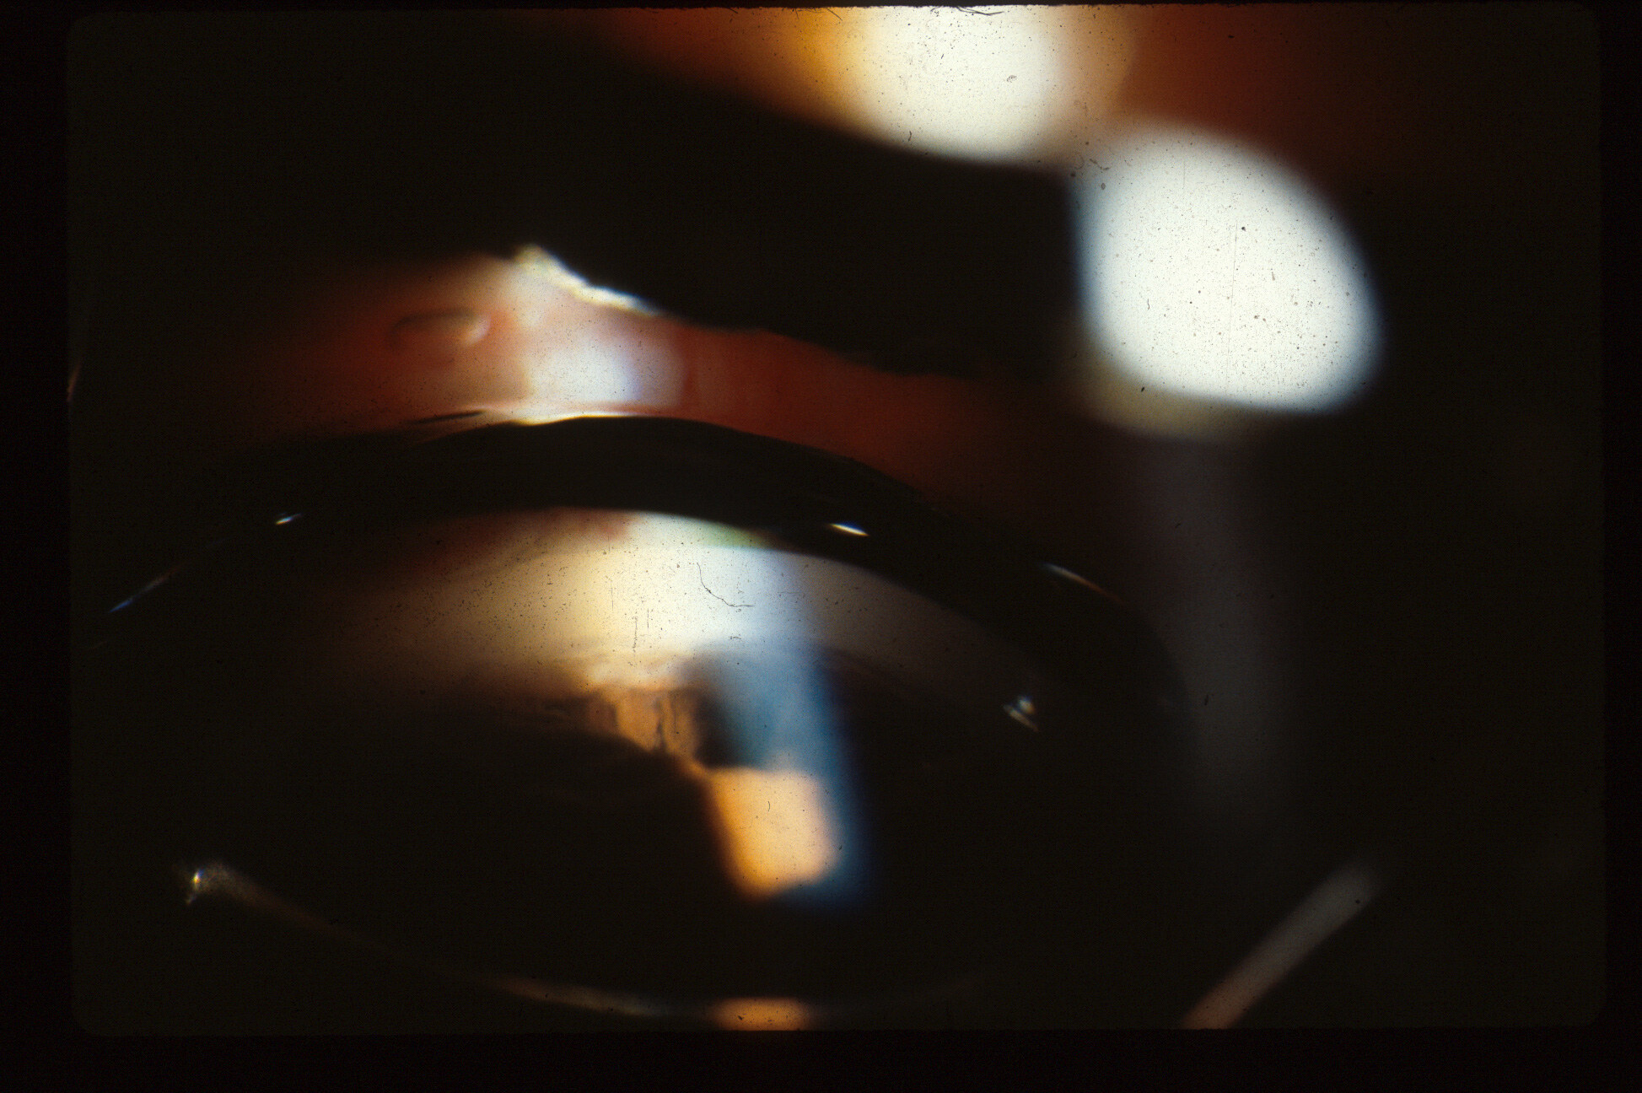
CB processes move back with indentation
Notes:
With indentation gonioscopy one sees that the appostional closure is temporarily reversed. Since there cannot be a pressure gradient between the anterior and posterior chambers in the presence of that surgical irdectomy, the mechanism is that increasing the intraocular pressure by indentation is stretching the corneal-scleral ring, which results in a posterior rotation of the ciliary body processes. This mechanism also helps to explain why Goldmann gonioscopy, which elevates the intraocular pressure by creating a suction cup effect, artifactually opens appositionaly closed angles, and SHOULD NOT BE USED in evaluating patients for angle closure.

Slide 25
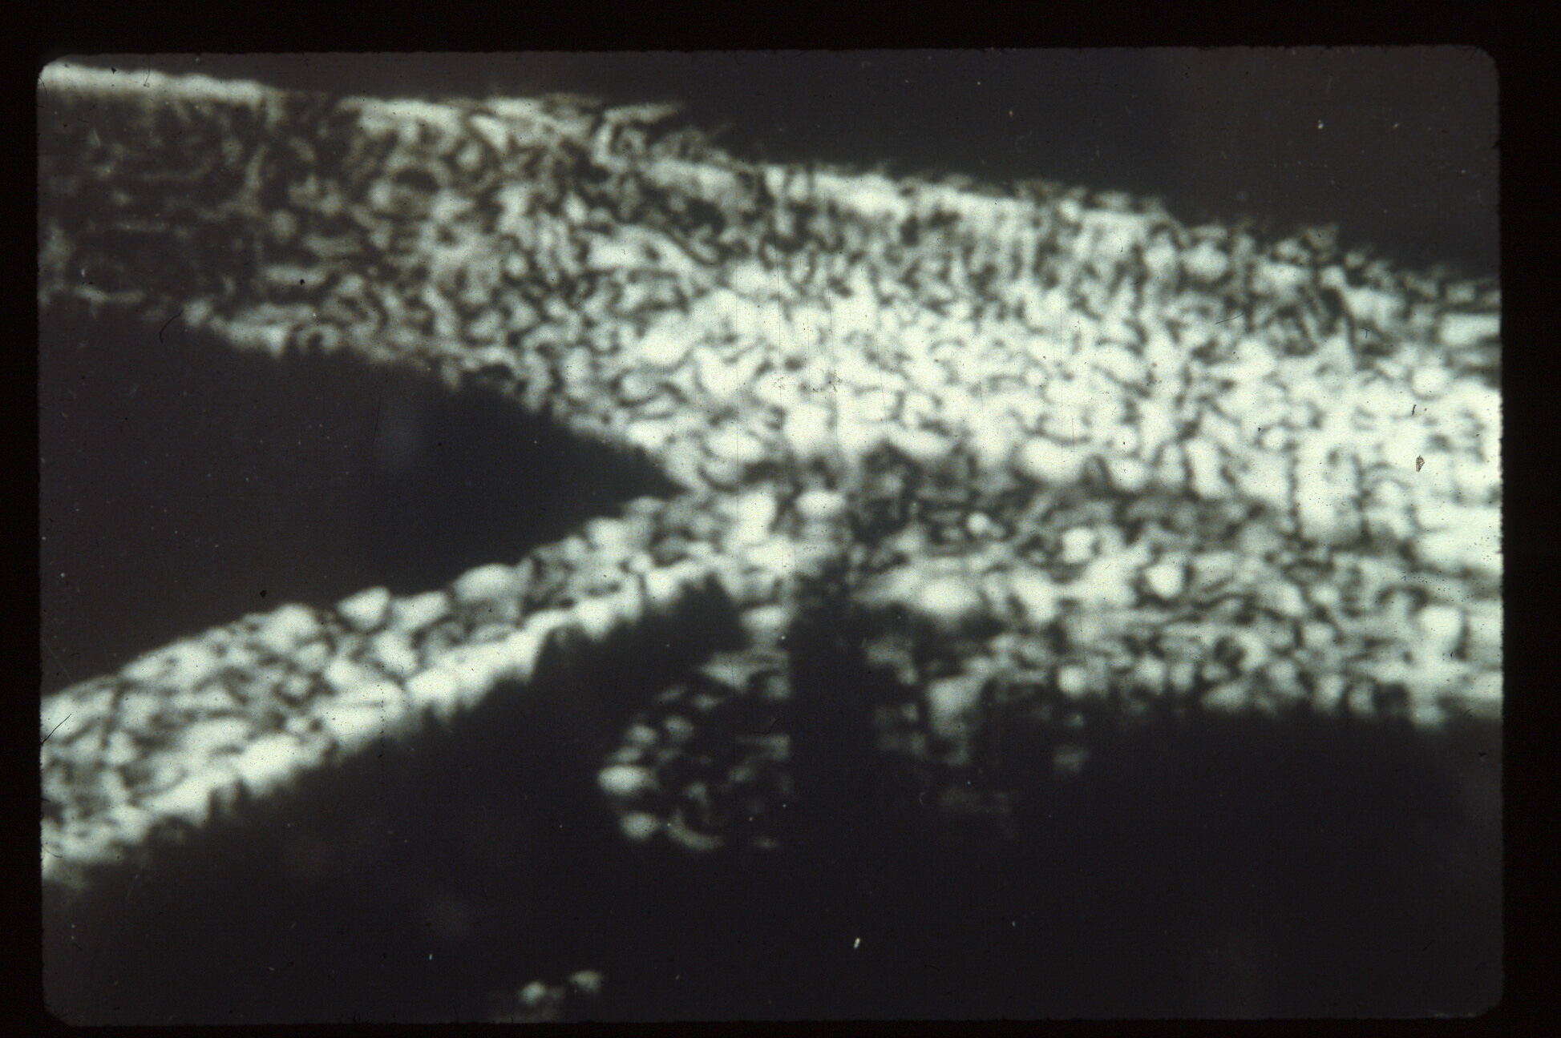
Normal angle UBM, from Ritch
Notes:
Ultrasound Biomicroscopy of a normal angle, courtesy of Bob Ritch.

Slide 26
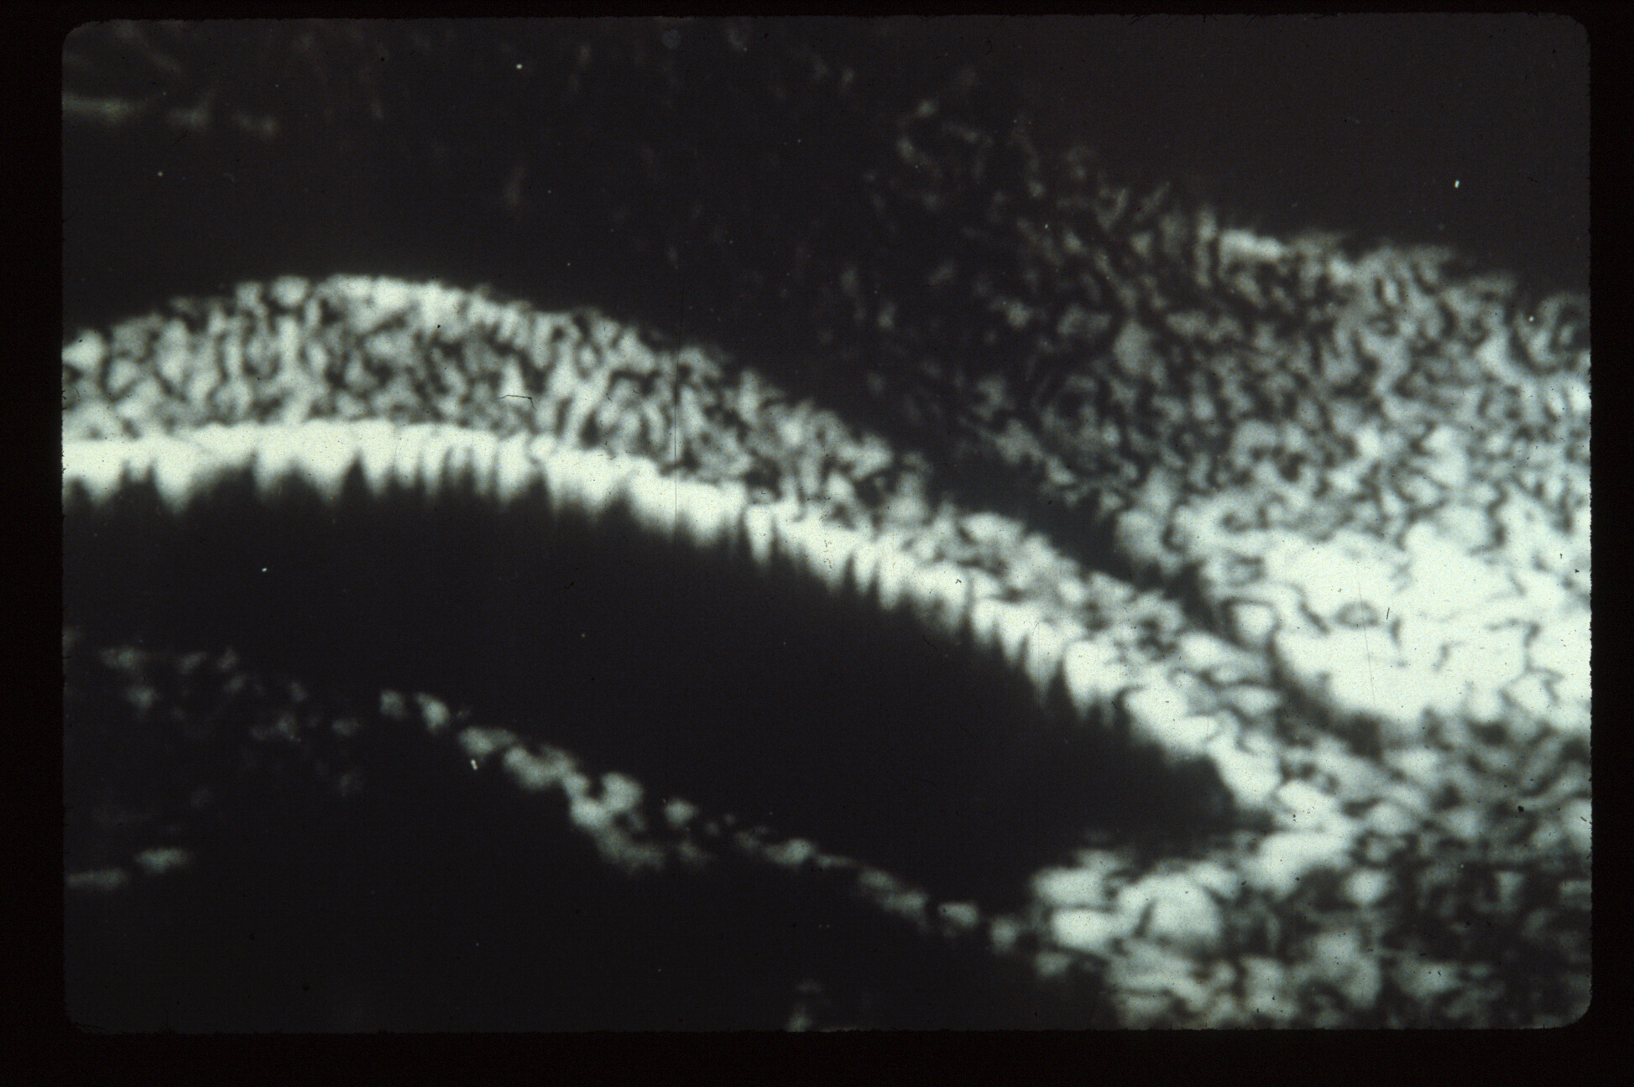
Pupil block angle closure UBM from Ritch
Notes:
UBM of pupil block angle closure, viewed in the dark.

Slide 27
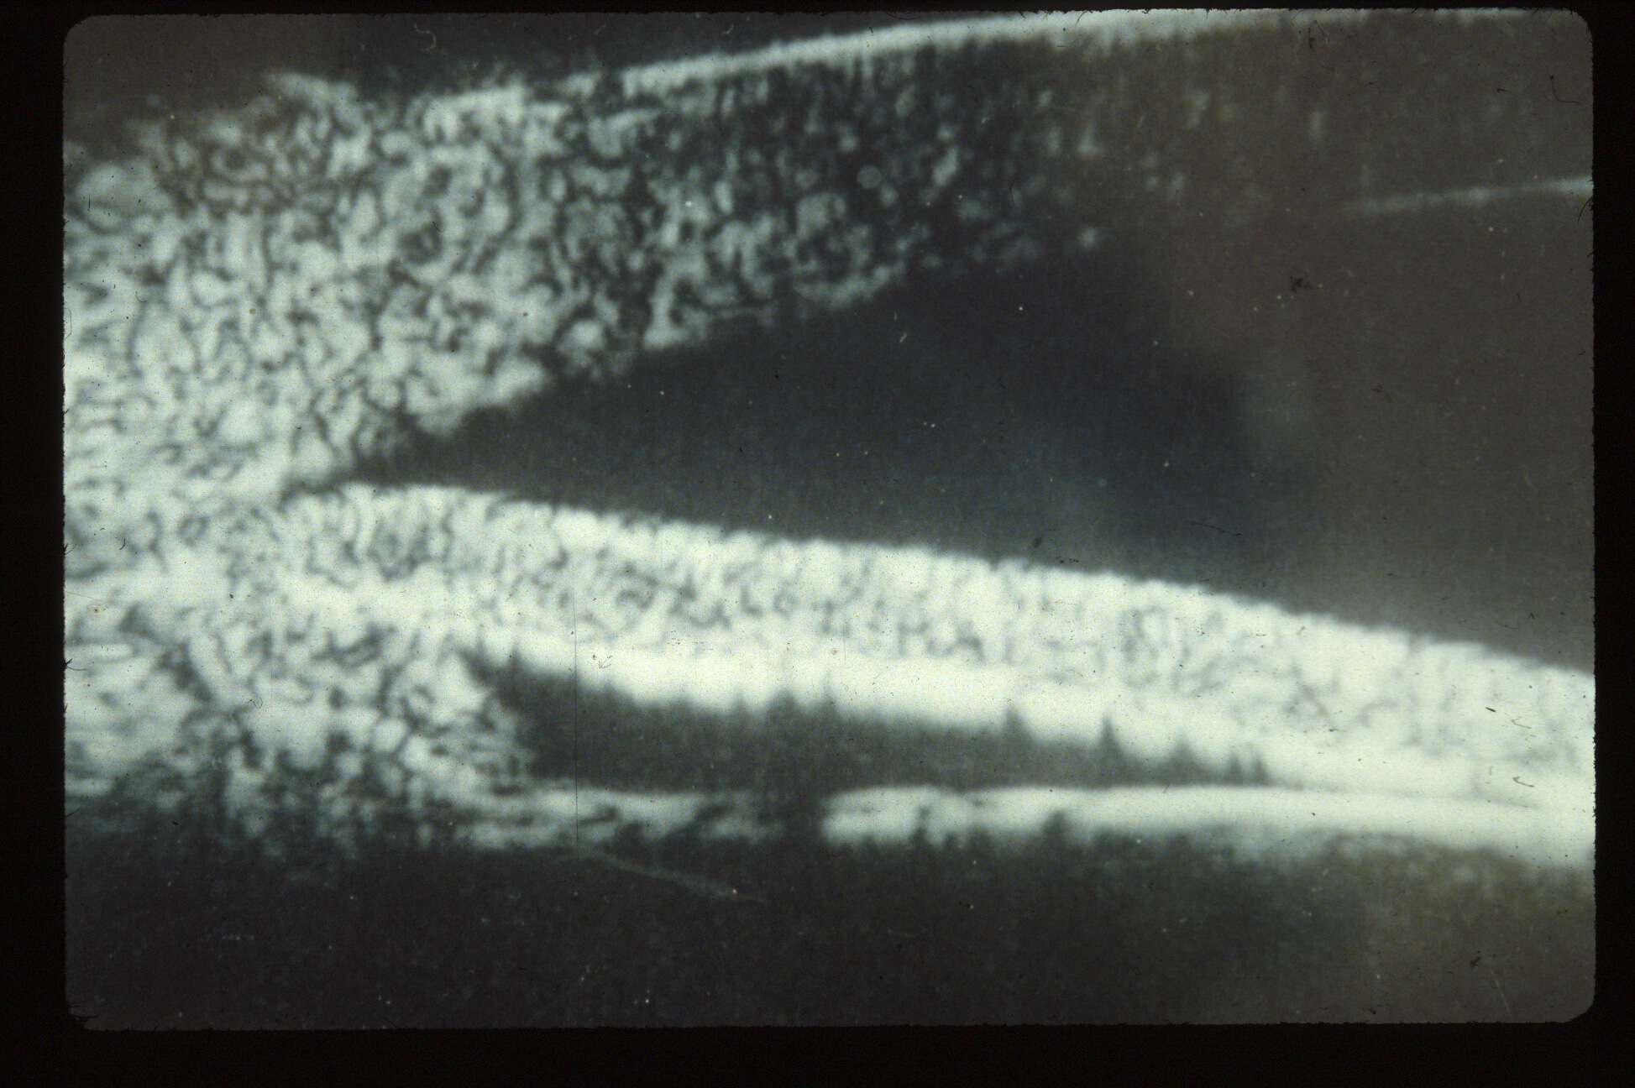
Plateau iris syndrome angle closure, CB processes rolled forward, UBM from Ritch
Notes:
UBM of plateau iris angle closure

Slide 28
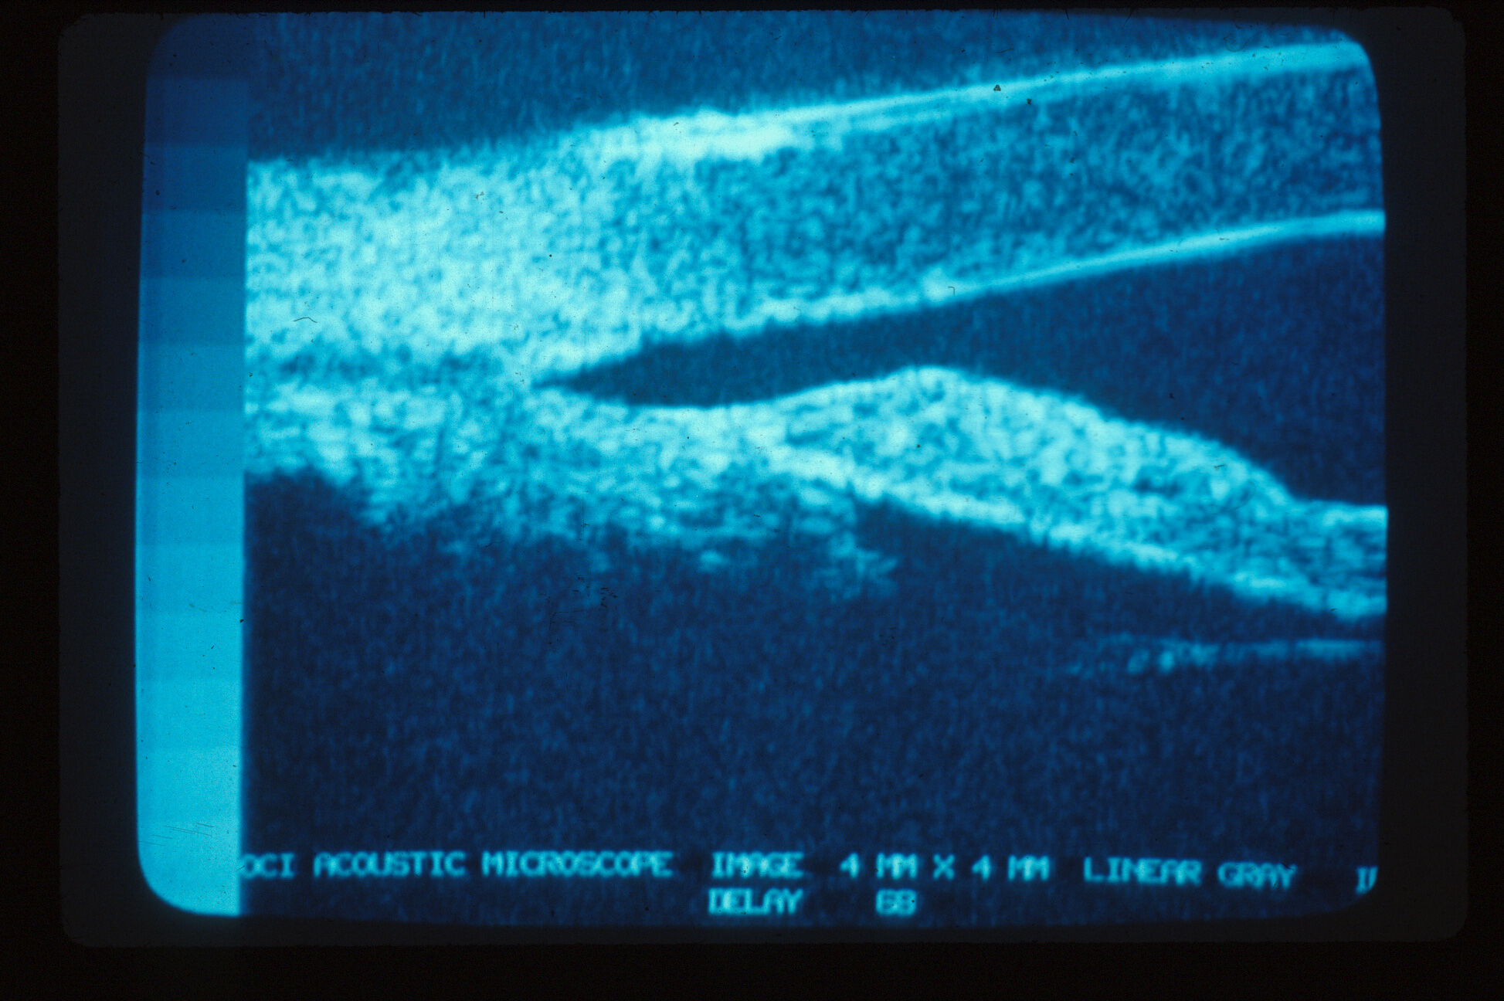
After laser iridoplasty, UBM from Ritch
Notes:
UBM of plateau iris after Argon laser peripheral iridoplasty

Slide 29
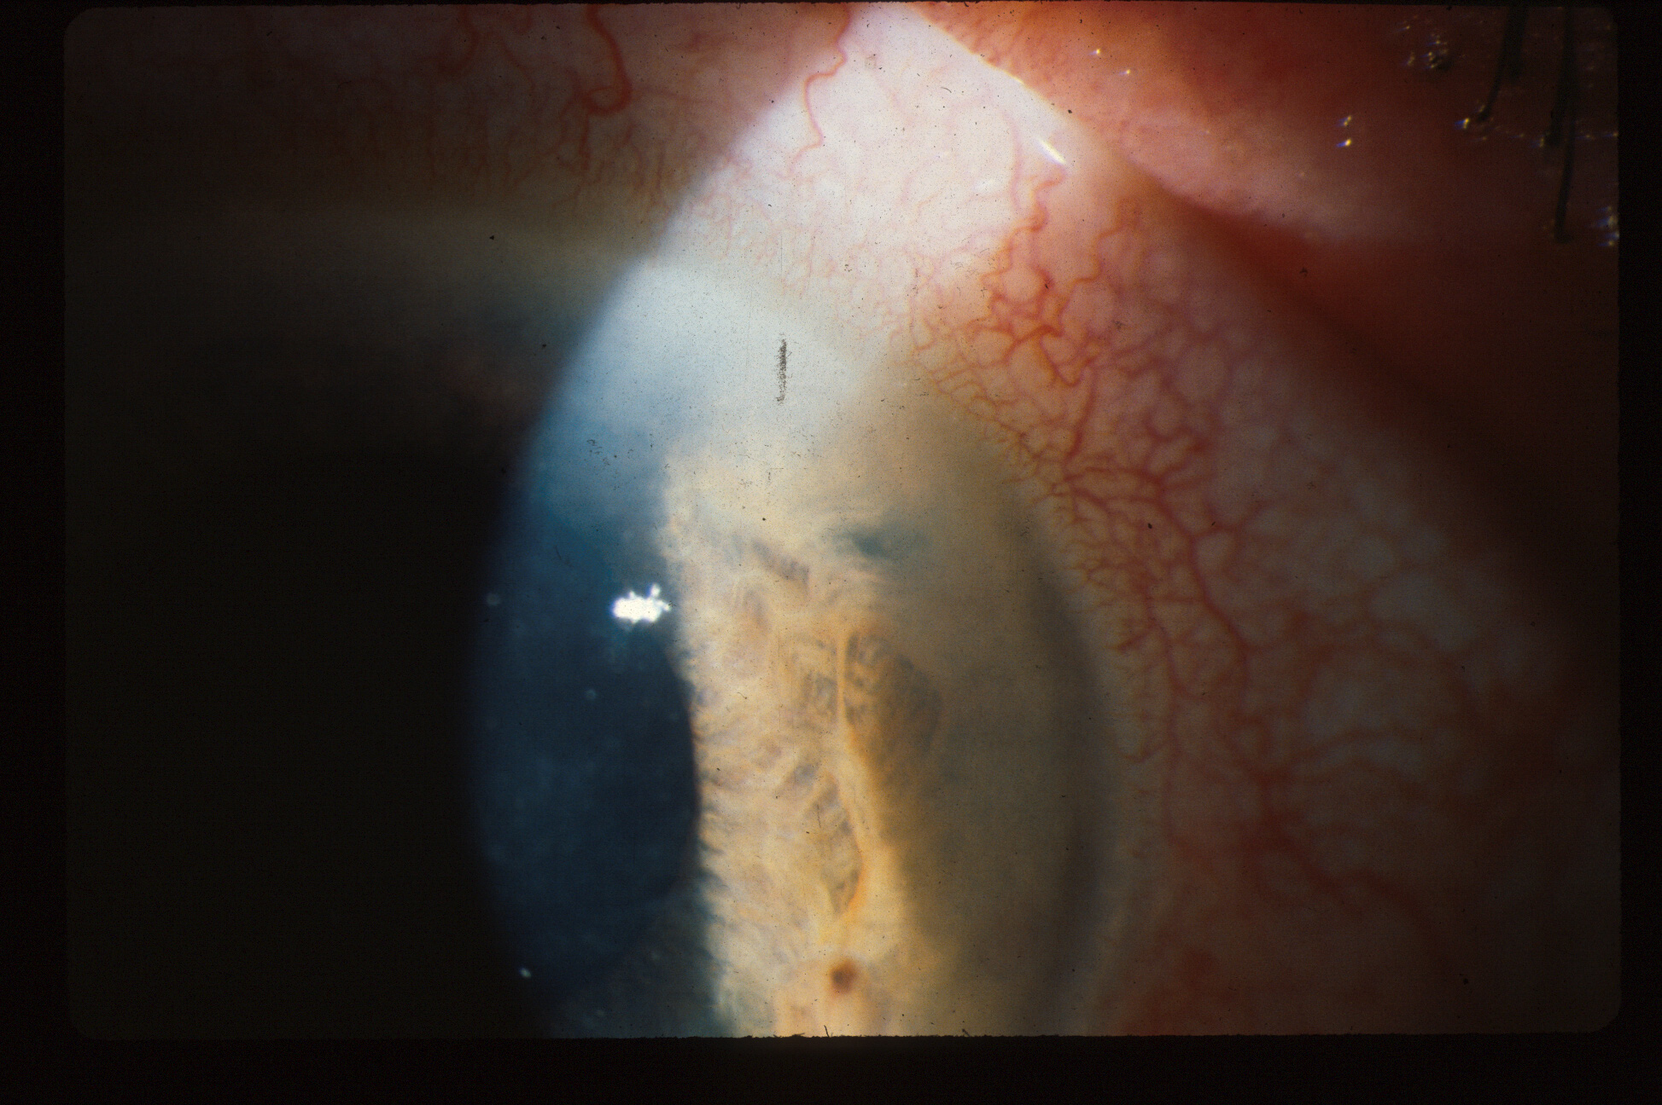
Patient had IOP of 12 before dilation, then 70 that evening, still 40 after LPI, Why? What should you do?
Notes:
Illustration of a case of pseudo-plateau iris syndrome. A patient with an IOP of 12 in the afternoon was dilated for a retinal exam, presented with pupil block angle closure and IOP of 70, not relieved by an LPI. The cause is ciliary body swelling due to ischemia, producing a temporary second mechanism of angle closure.

Slide 30
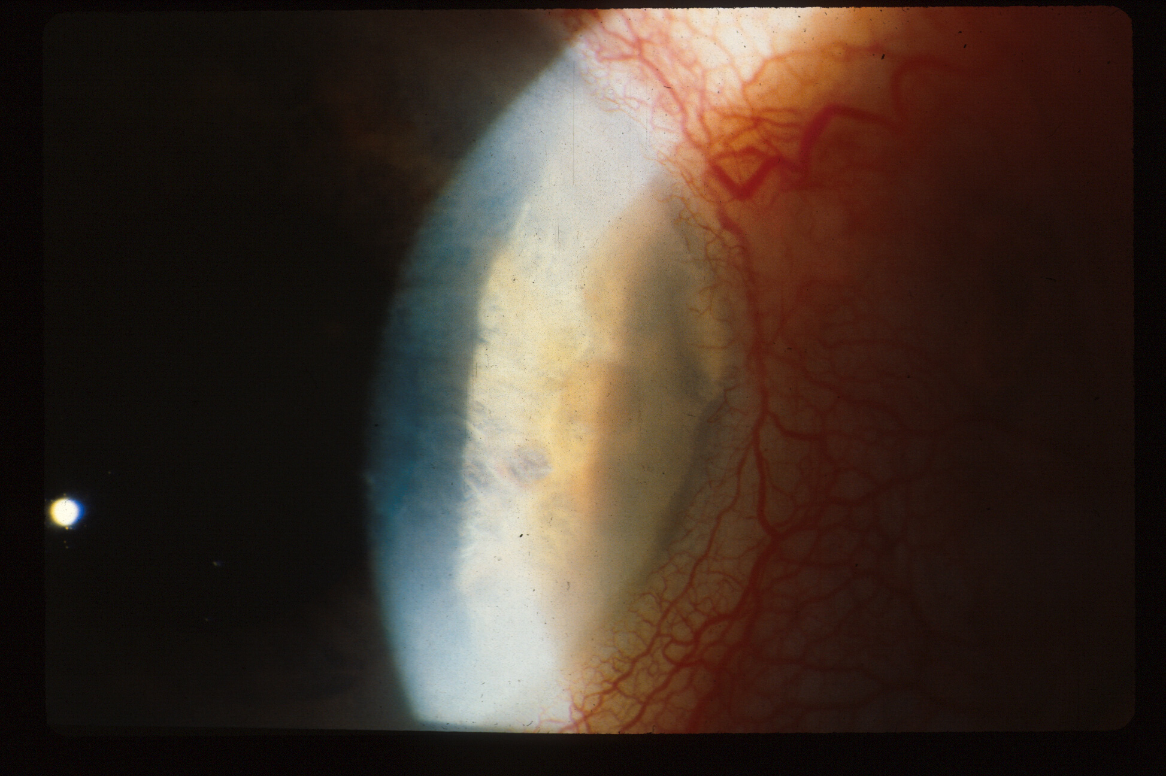
Received Laser iridoplasty, 500u, 1 sec, 0.18w,
first shot slightly away from periphery, rest in periphery, 36 applications, for pseudo plateau iris syndrome due to ciliary body congestion
Notes:
This was relieved by some applications of peripheral iridoplasty.

Slide 31
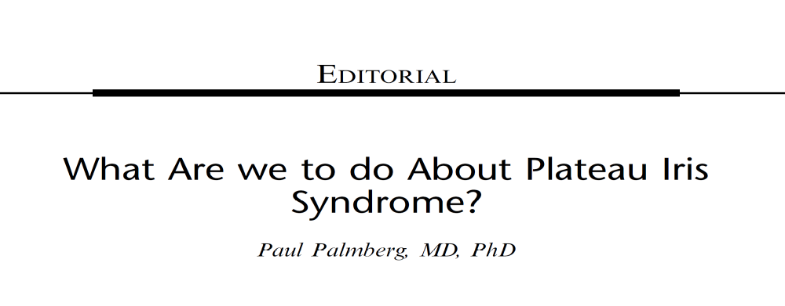
Staging Angle Closure to Decide What to Do
I recommend the same strategy for staging pupil block and plateau iris syndrome:
For appositional closure: laser iridotomy and/or iridoplasty
For mixed appositional and synechial—maybe lens extraction
For complete synechial closure or advanced damage—filter!
J Glaucoma 2019:28(9):765

Slide 32
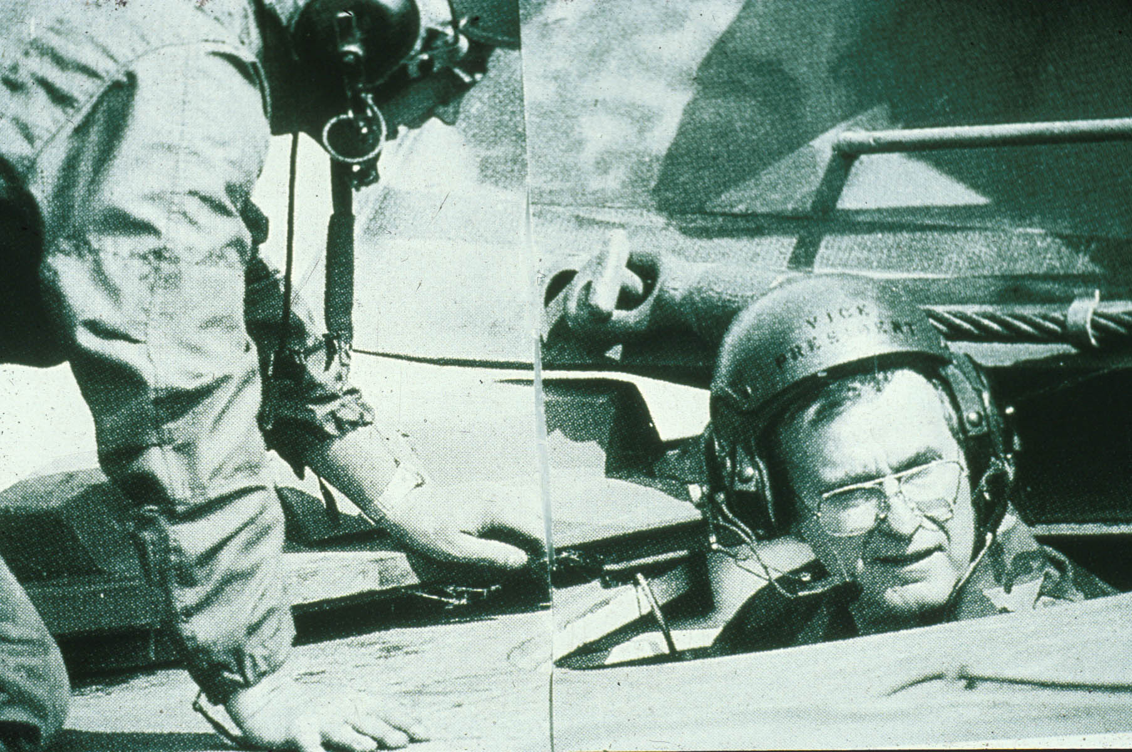
I will be tough on angle closure.

